Slide 1



DATA ANALYST PROJECT PRESENTATION
RAPIDO
RIDE ANALYSIS
Power BI Dashboard Project
PRESENTED BY: ABINAYA J
EXCEL + POWER BI
27
DATA ANALYSIS
& VISUALIZATION
SLIDE ANALYSIS
RAPIDO RIDE ANALYSIS | POWER BI PROJECT | ABI
01

Slide 2




01 / CONTEXT
INTRODUCTION
Rapido is a bike taxi and mobility
service platform.
DATASET CONTAINS
Raw
Bookings, customers, and
drivers
This project analyzes Rapido ride
booking data using Power BI.
rides.
Vehicles and payment
methods
Clear
Ride performance and ratings
answers.
WHY POWER BI?
Power BI transforms raw ride data into meaningful dashboards and
visualizations, helping identify important trends and patterns in
bookings.
RAPIDO RIDE ANALYSIS | POWER BI PROJECT | ABI
02

Slide 3


PROJECT FRAMING
02 / FRAMING
PROBLEM STATEMENT
ASK
WHY?
The main purpose of this project is to analyze ride booking data
and understand:
Total bookings and revenue
Completed and cancelled rides
Customer and driver performance
Vehicle type usage
Payment method usage
Ride distance and ride time
Customer and driver ratings
Incomplete rides and their reasons
A DECISION-READY VIEW OF RIDE PERFORMANCE
RAPIDO RIDE ANALYSIS | POWER BI PROJECT | ABI
03

Slide 4

03 / INTENT
PROJECT OBJECTIVES
01
02
03
Analyze overall booking
performance.
Analyze customer and driver
activity.
Understand ride distance and ride
time.
Calculate total revenue generated.
Compare different vehicle types.
Analyze customer and driver
ratings.
Identify completed and cancelled
bookings.
Analyze payment methods.
Identify important business
insights from the dashboard.
FROM RAW RECORDS → TO BUSINESS QUESTIONS
04

Slide 5


04 / TOOLKIT
TOOLS USED
X
BI
MICROSOFT EXCEL
MICROSOFT POWER BI
Dataset storage.
Data cleaning, transformation, DAX
calculations, KPI creation, visualization, and the
interactive dashboard.
PREPARE THE SOURCE
TURN DATA INTO A VIEW
RAPIDO RIDE ANALYSIS | POWER BI PROJECT | ABI
05

Slide 6
05 / SOURCE
DATASET OVERVIEW
The dataset contains information related to Rapido rides.
01
02
03
04
05
Booking ID
Booking Status
Booking Value
Customer ID
Driver ID
06
07
08
09
10
Pickup Location
Drop Location
Ride Distance
Ride Time
Date & Time
11
12
13
14
15
Vehicle Type
Payment Method
Customer Rating
Driver Rating
Cancellation Flags
16
17–18
Incomplete Ride
Incomplete Ride Reason · Ride performance
RAPIDO RIDE ANALYSIS | POWER BI PROJECT | ABI
06

Slide 7


06 / METHOD
DATA CLEANING & PROCESSING
Preparing the source so every dashboard view answers a clean question.
01
02
03
04
05
Checked the dataset
for missing values.
Checked duplicate
records.
Verified data types.
Formatted date and
time columns.
Checked numerical
columns.
STANDARDIZED CATEGORICAL VALUES · PREPARED THE DATA FOR POWER BI · CREATED CALCULATED MEASURES USING
DAX
RAW DATA
CLEANING TRANSFORMATION
→
→
DASHBOARD
WORKFLOW
→
RAPIDO RIDE ANALYSIS | POWER BI PROJECT | ABI
07

Slide 8

07 / SCORECARD
KEY PERFORMANCE INDICATORS

Slide 9

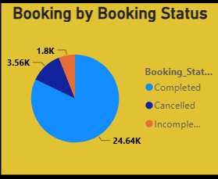
09 / BOOKING HEALTH
BOOKING STATUS ANALYSIS
BUSINESS QUESTION
COLUMN / DONUT CHART
How are bookings distributed by booking status?
This graph the distribution of Rapido bookings based
on their booking status.
It helps us understand how many rides were successfully
completed and how many rides were cancelled or
incomplete.
BOOKING STATUS
RAPIDO RIDE ANALYSIS | POWER BI PROJECT | ABI
10

Slide 10
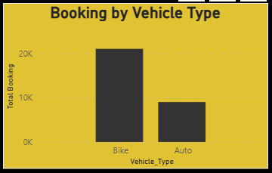
10 / MONEY TRAIL
BOOKING BY VEHICEL TYPE
BUSINESS QUESTION
What is the total booking value by vehicle type?
TOTAL BOOKING
This graph shows the total booking value
generated by each vehicle type. It helps
us compare which vehicle types
contribute more to the overall booking
revenue
RAPIDO RIDE ANALYSIS | POWER BI PROJECT | ABI
11

Slide 11
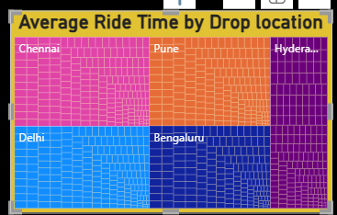
11 / DEMAND MAP
AVERAGE RIDE TIME BY DROP LOCATION
BUSINESS QUESTION
How much time does it take to drop the customer at time location?
shows the average time taken to drop customers
at different drop locations.
The size of each box represents the average ride
time for that location.
Larger boxes indicate locations with higher
average ride time.
RAPIDO RIDE ANALYSIS | POWER BI PROJECT | ABI
12

Slide 12
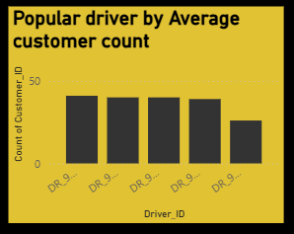
12 / DRIVER ACTIVITY
POPULAR DRIVER BY CUSTOMER COUNT
BUSINESS QUESTION
Which driver has the highest number of customers?
This graph shows the number of customers handled
by each driver.
The driver names are displayed on the X-axis, and the
number of customers is displayed on the Y-axis.
From the char t, we can identify which driver has the
highest number of customers.
The driver with the tallest column has served the
highest number of customers.
RAPIDO RIDE ANALYSIS | POWER BI PROJECT | ABI
13

Slide 13
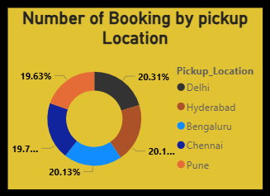
13 / CUSTOMER ACTIVITY
NUMBER OF BOOKING BY PICKUP
LOCATION
BUSINESS QUESTION
How many booking are made in each pickup location ?
This graph chart shows the number of bookings made from each pickup location.
The pickup locations are displayed on the X-axis, and the number of bookings is displayed on the Y-axis. compare booking demand across different pickup locations.
The location with the tallest column has the highest number of bookings.
RAPIDO RIDE ANALYSIS | POWER BI PROJECT | ABI
14

Slide 14
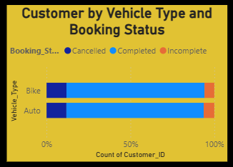

14 / VEHICLE MIX
CUSTOMER BY VEHICLE TYPE
BUSINESS QUESTION
Which vehicle type used by the most customers?
This graph shows the number of customers using each vehicle type.
The vehicle types are displayed on the X-axis, and the number of customers is displayed on the Y-axis.
This chart helps us understand which vehicle type is most preferred by customers.
The vehicle type with the tallest column is the most used by customers.
RAPIDO RIDE ANALYSIS | POWER BI PROJECT | ABI
15

Slide 15
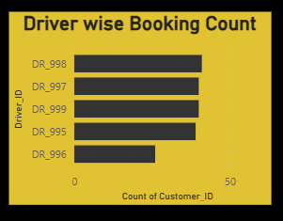
16 / CANCELLATION LENS
DRIVER WISE BOOKING COUNT
BUSINESS QUESTION
Which driver has the most customer ?
This bar chart shows the number of customers served by each driver.
The driver names are shown on the Y-axis, and the number of customers is shown on the X-axis.
The longest bar represents the driver who has the highest number of customers.
RAPIDO RIDE ANALYSIS | POWER BI PROJECT | ABI
17

Slide 16
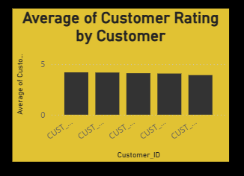
15 / PAYMENT BEHAVIOR
BOOKINGS BY PAYMENT METHOD
BUSINESS QUESTION
How many customer gave the highest rating?
This column chart shows the number of customers for each rating level.
The rating is shown on the X-axis, and the number of customers is shown on the Y-axis.
This chart helps us identify how many customers gave the highest rating. The tallest column represents the rating given by the highest number of customers
RAPIDO RIDE ANALYSIS | POWER BI PROJECT | ABI
16

Slide 17
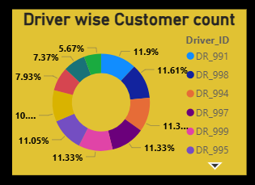
17 / CUSTOMER FRICTION
DRIVER WISE CUSTOMER COUNT
BUSINESS QUESTION
Which driver has the highest number of customer?
This donut chart shows the distribution of customers across different drivers.
Each section represents the number of customers served by a driver.
The largest section represents the driver with the highest number of customers.
RAPIDO RIDE ANALYSIS | POWER BI PROJECT | ABI
18

Slide 18
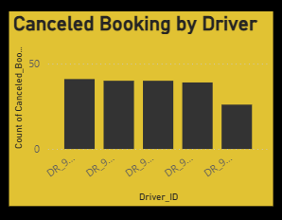
18 / DRIVER FRICTION
CANCELED BOOKING BY DRIVER
BUSINESS QUESTION
This column chart shows the number of cancelled rides for each driver.
The driver names are shown on the X-axis, and the number of cancelled rides is shown on the Y-axis.
The tallest column represents the driver with the highest number of cancelled rides.”
which driver has the most cancelled ride?
RAPIDO RIDE ANALYSIS | POWER BI PROJECT | ABI
19

Slide 19
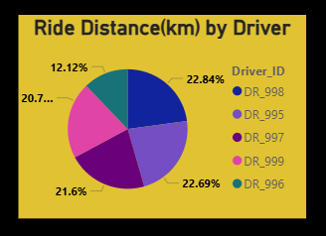
19 / DISTANCE
RIDE DISTANCE BY DRIVER
BUSINESS QUESTION
Which driver has highest ride distance?
This pie chart shows the distribution of total ride distance across different drivers.
Each slice represents the ride distance covered by a driver.
The largest slice represents the driver with the highest total ride distance.
RAPIDO RIDE ANALYSIS | POWER BI PROJECT | ABI
20

Slide 20
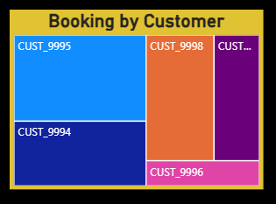
20 / DURATION
BOOKING BY CUSTOMER
BUSINESS QUESTION
Which customer has the highest number of booking ?
This treemap shows the number of bookings made by each customer.
Each box represents a customer, and the size of the box represents the number of bookings.
The largest box represents the customer with the highest number of bookings.”
RAPIDO RIDE ANALYSIS | POWER BI PROJECT | ABI
21

Slide 21
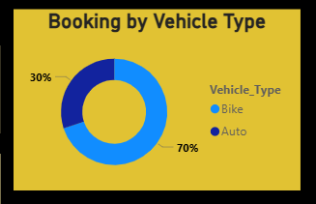
21 / FEEDBACK LOOP
BOOKING BY VEHICLE TYPE
BUSINESS QUESTION
Which vehicle type has the most customer?
This pie chart shows the distribution of customers across different vehicle types.
Each slice represents the number of customers using a particular vehicle type.
The largest slice represents the vehicle type used by the highest number of customers.
[n.n]
RAPIDO RIDE ANALYSIS | POWER BI PROJECT | ABI
22

Slide 22
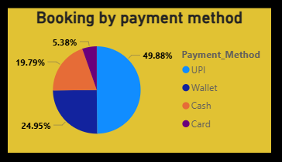
22 / EXCEPTION ANALYSIS
BOOKING BY PAYMENT
BUSINESS QUESTION
How many payment types are used by customers?
This pie chart shows how many customers use each payment type.
It helps us understand the payment preferences of customers and identify the most commonly used payment type.
RAPIDO RIDE ANALYSIS | POWER BI PROJECT | ABI
23

Slide 23
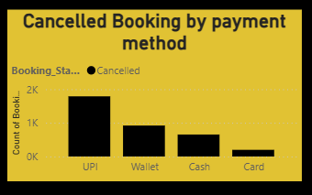
23 / RHYTHM
CANCELLED BOOKING BY PAYMENT METHOD
BUSINESS QUESTION
How many payment types are used by customer?
This column chart shows the number of customers using different payment types.
It helps us compare the payment types and identify which payment type is used by the most customers.
RAPIDO RIDE ANALYSIS | POWER BI PROJECT | ABI
24

Slide 24
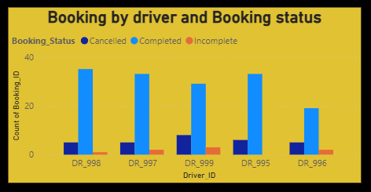
24 / SYNTHESIS
BOOKING BY DRIVER AND BOOKNGS STATUS
How many ride are completed ,incomplete and cancelled by each driver ?
This chart shows the number of completed, incomplete, and cancelled rides for each driver.
It helps us compare the ride status of each driver and understand their overall ride performance.

Slide 25
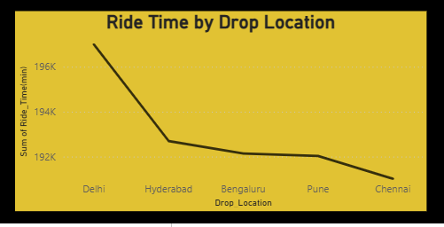
24 / SYNTHESIS
RIDE TIME BY DROP LOCATION
What is the total ride time for each drop location?
This line chart shows the total ride time for each drop location.
It helps us compare the ride duration across different drop locations and identify which locations have the highest and lowest total ride time.
RAPIDO RIDE ANALYSIS | POWER BI PROJECT | ABI
25

Slide 26

25 / CLOSE
CONCLUSION
The Rapido dataset provides useful information
about ride bookings and performance.
DASHBOARD MAKES IT EASIER TO MONITOR
Bookings
Revenue
Power BI helps convert raw ride data into meaningful
visual insights.
Customers
Drivers
Vehicles
Payments
Ride performance
.
RAPIDO RIDE ANALYSIS | POWER BI PROJECT | ABI
26

Slide 27

RAPIDO RIDE ANALYSIS
THANK
YOU
From raw ride data to a
clearer view of mobility.
Presented by: Abinaya J
POWER BI DASHBOARD PROJECT
RAPIDO RIDE ANALYSIS | POWER BI PROJECT | ABI
27

